Slide 1

First Committee Meeting!
Summer Blanco
January 23, 2022

Slide 2
Agenda
About me
Background
Big Picture
Questions
Current projects/experimental approaches
Classes
Outreach
Internship (maybe)

Slide 3
About me!

Slide 4

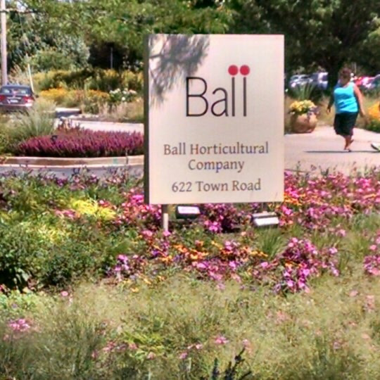









BS in Biology with Botany option
Undergraduate Internships
Undergraduate organizations
Post-bac training

Slide 5
Background

Slide 6

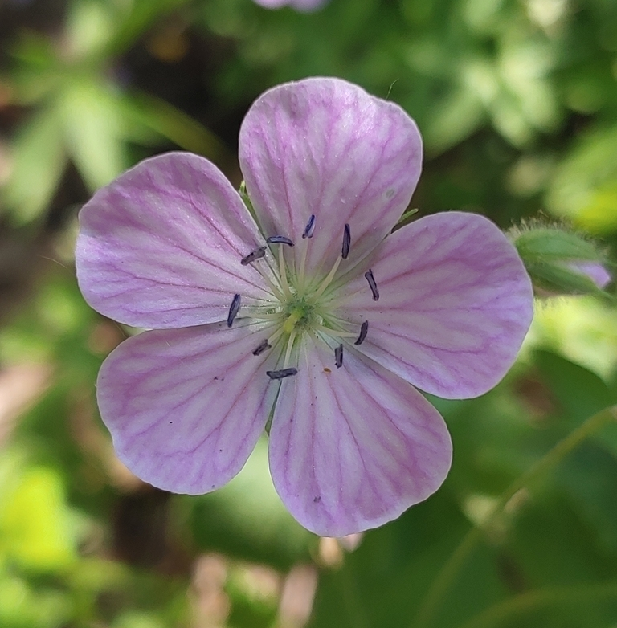
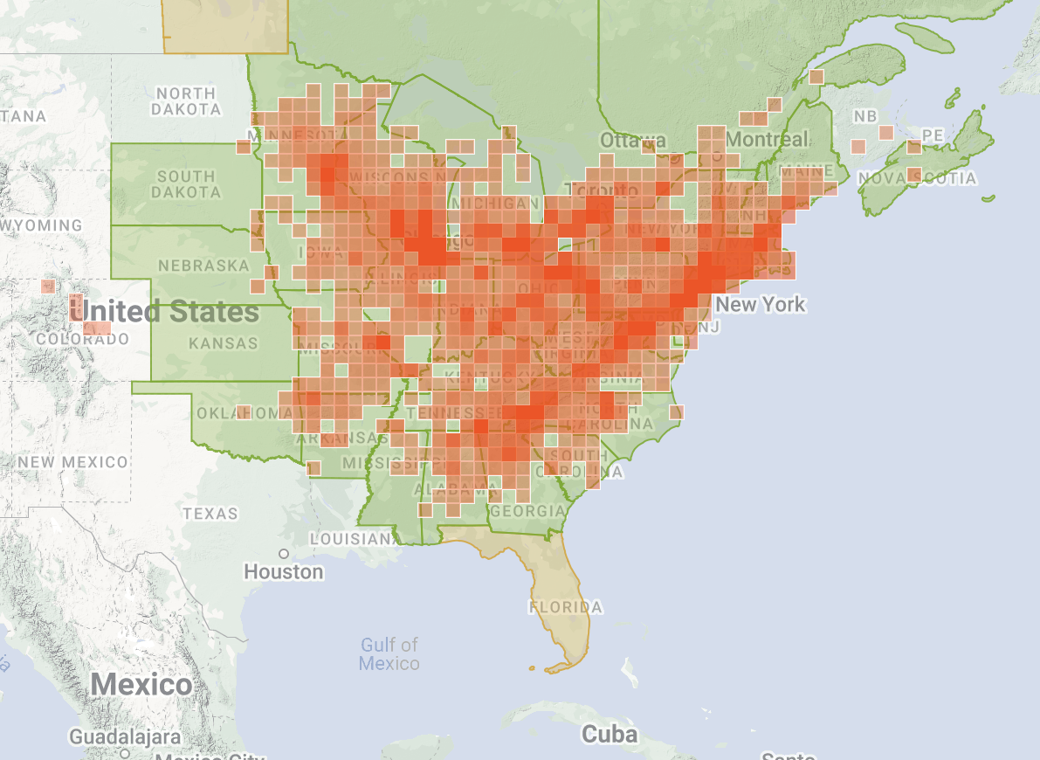
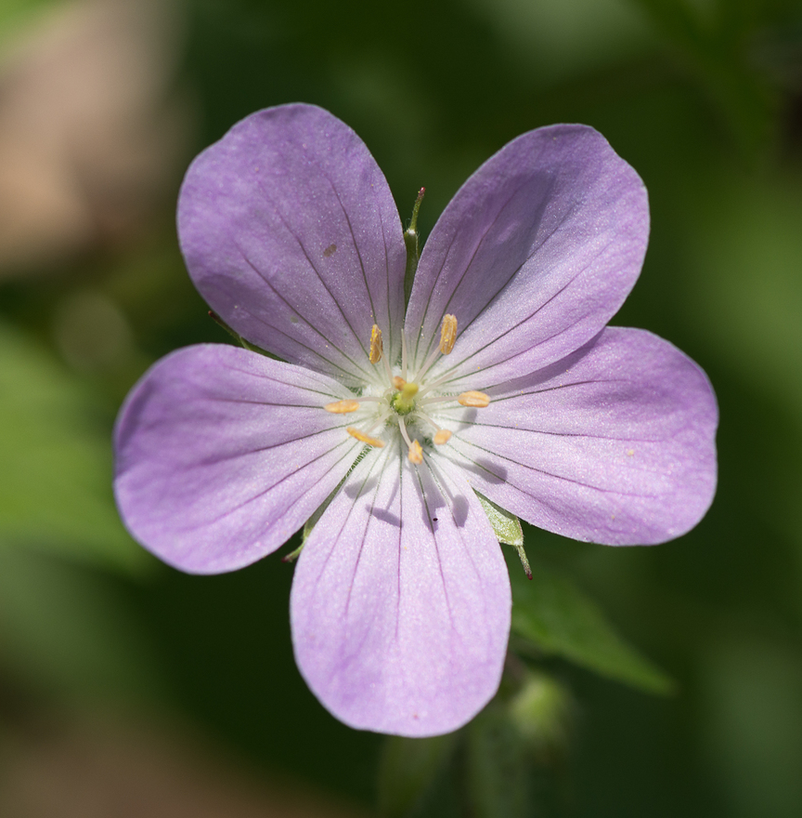
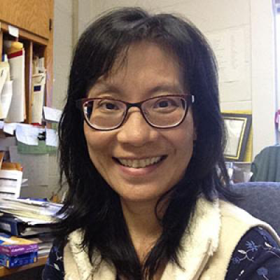
Study system: Geranium maculatum

Slide 7
Big Picture

Slide 8

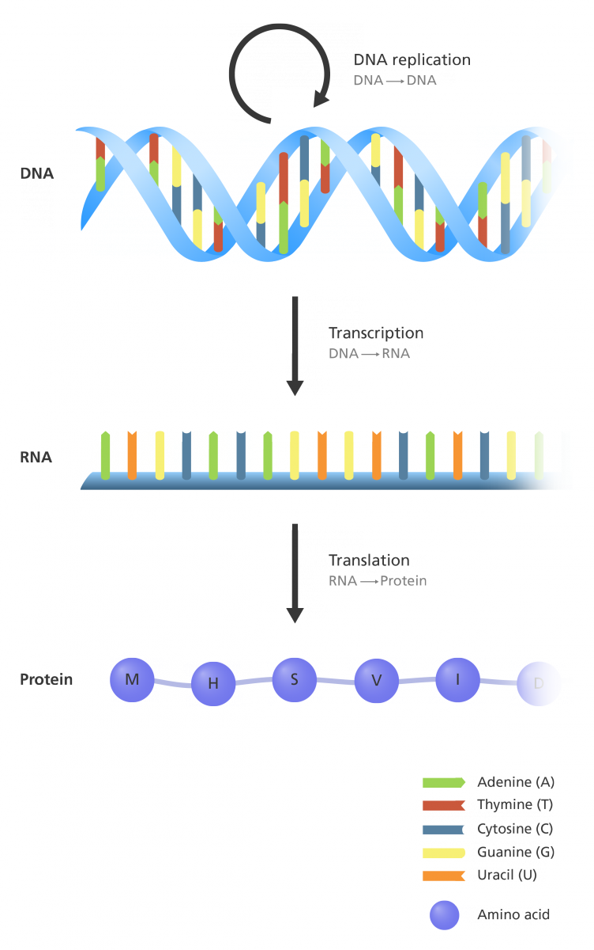
Genes → encoding biochemical pathway enzymes & transcription factors that regulate plant metabolism

Slide 9
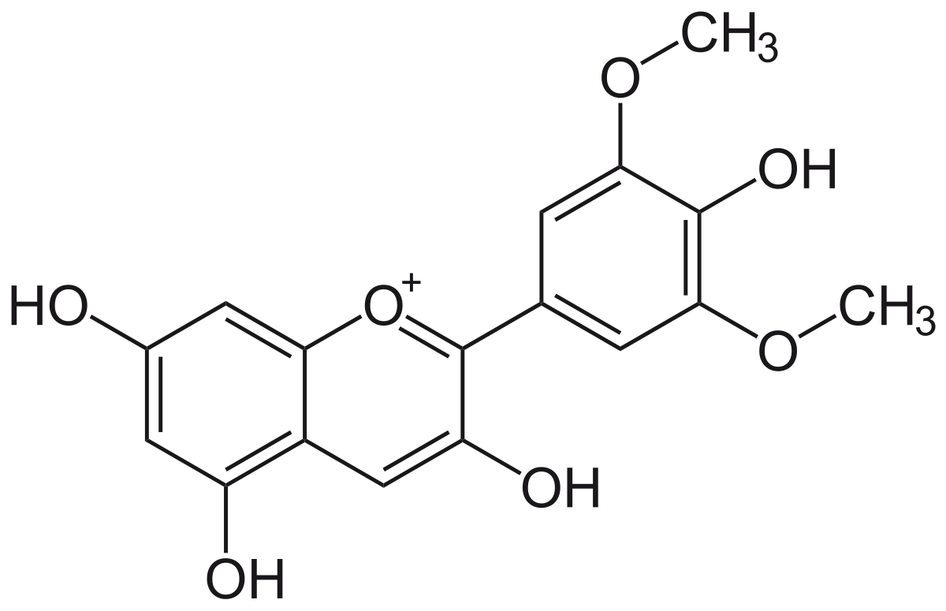
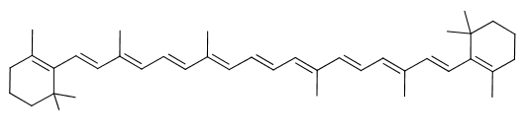
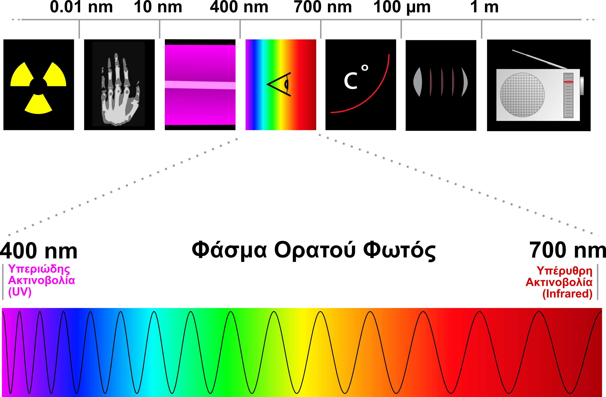
Genes → encoding biochemical pathway enzymes & transcription factors that regulate plant metabolism
→ Molecules that interact with light

Slide 10
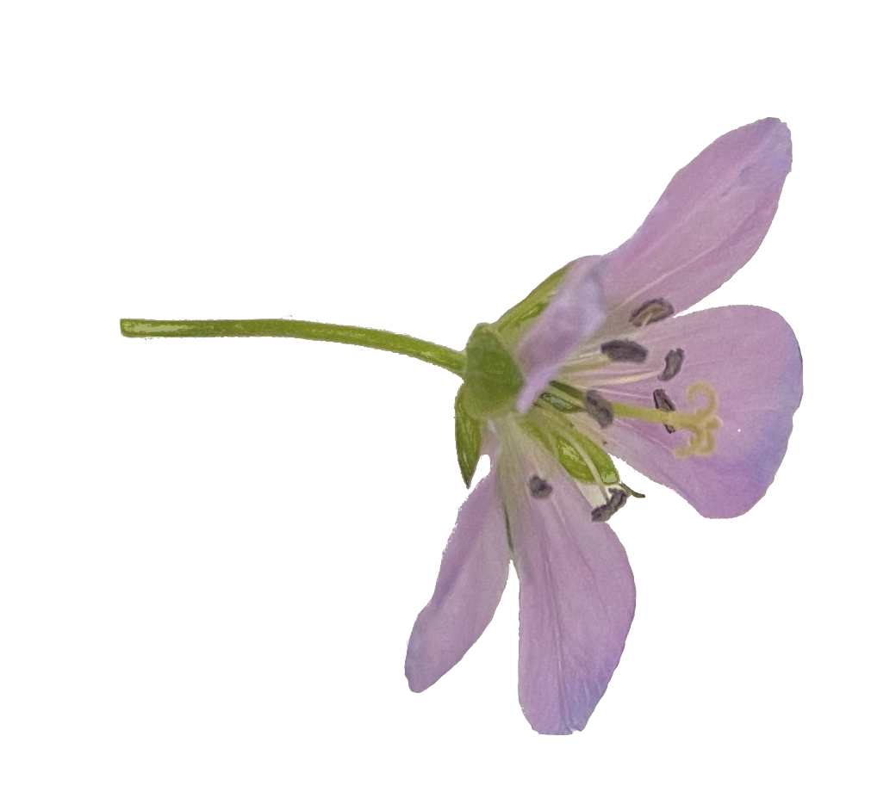
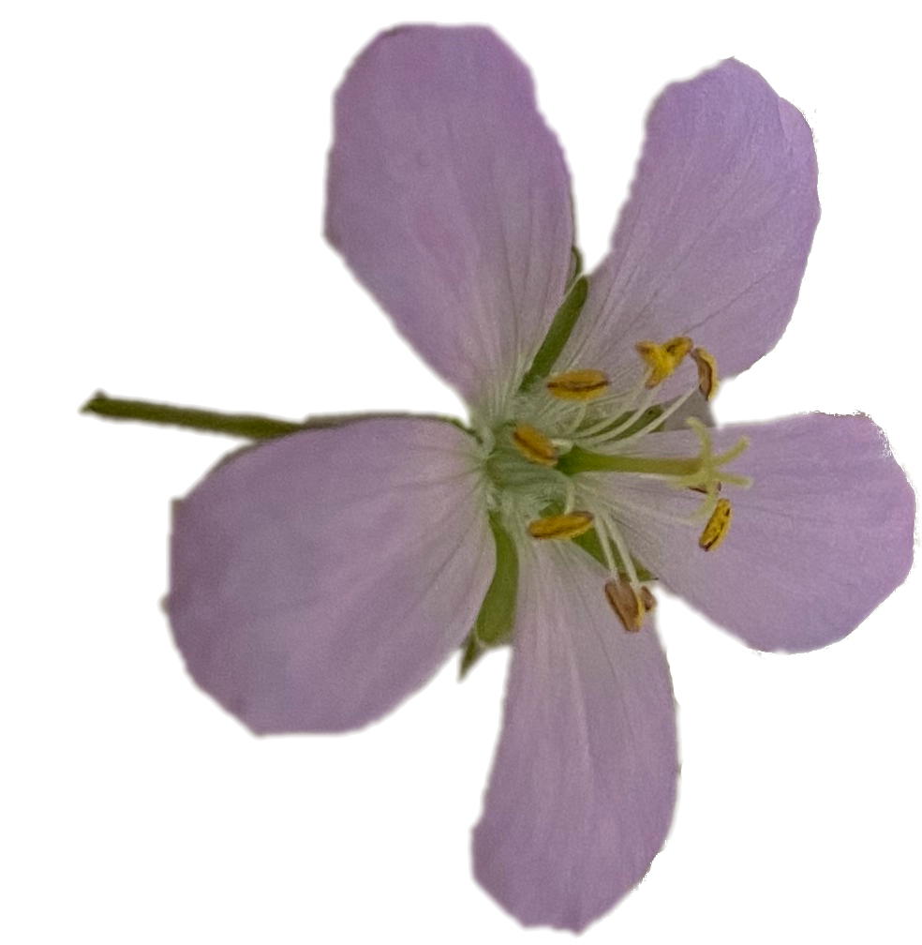
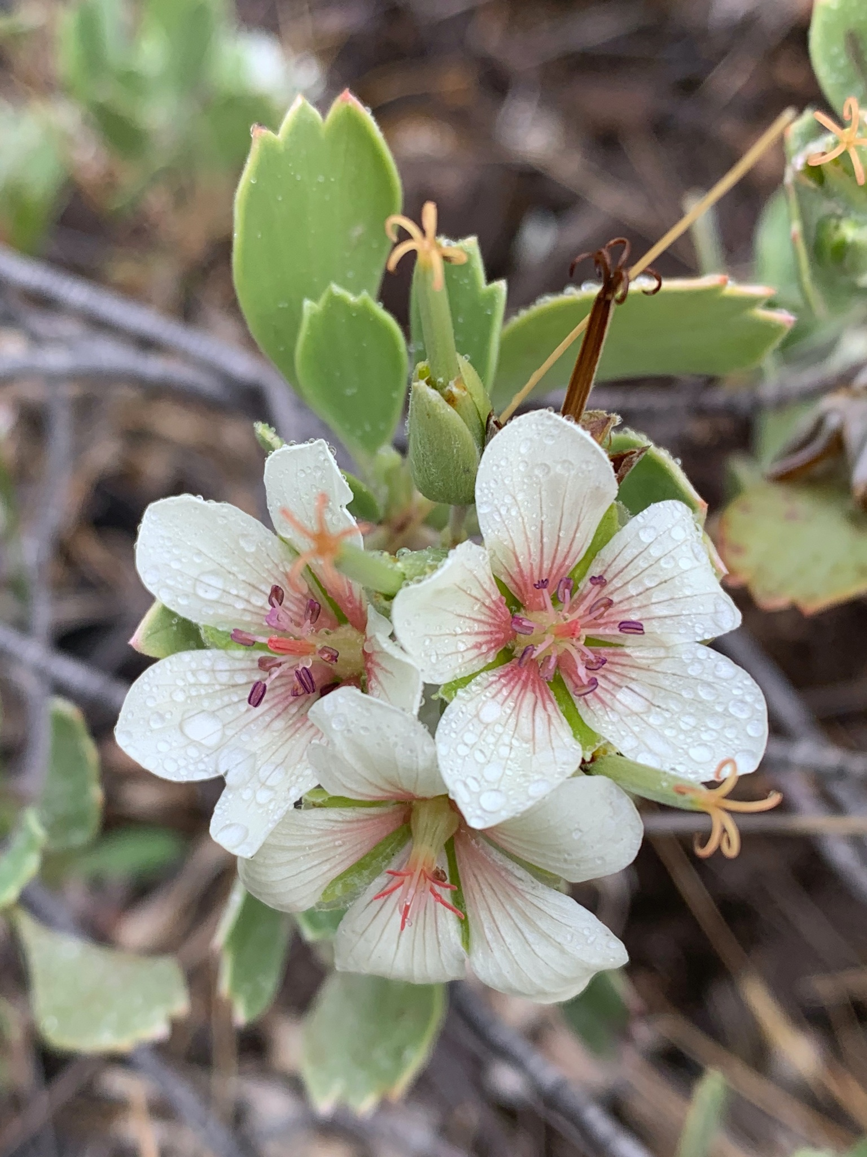
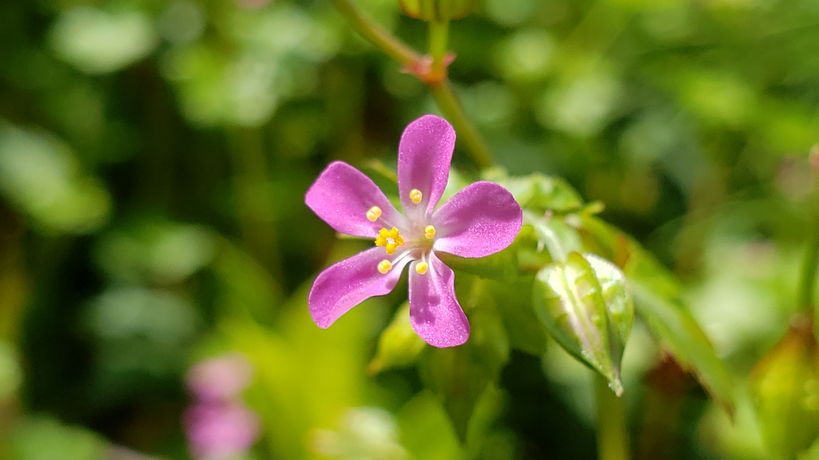
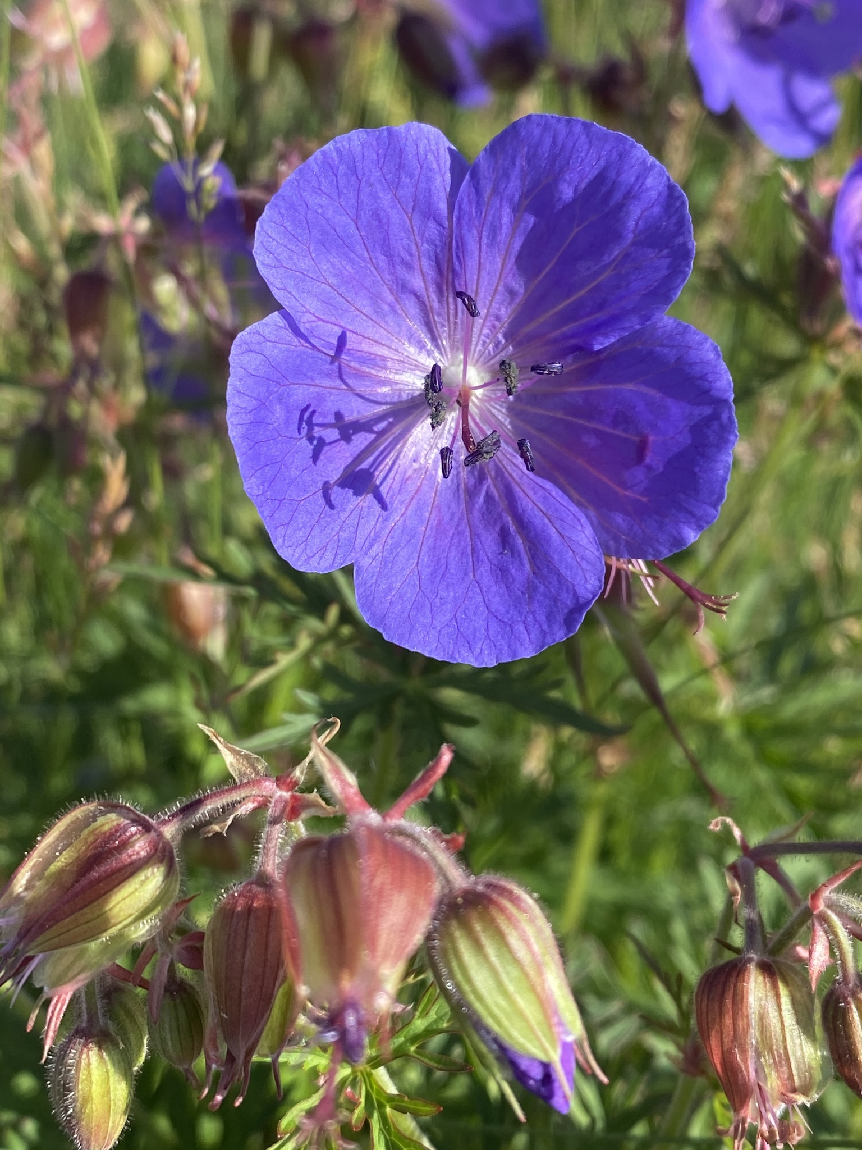
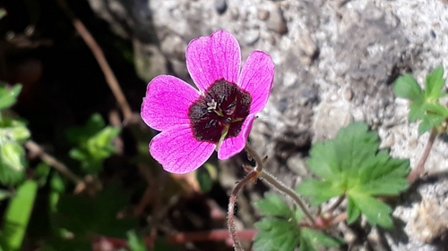
Genes → encoding biochemical pathway enzymes & transcription factors that regulate plant metabolism
→ Molecules that interact with light
→ Phenotypes → Diverge over time → Plant reproduction & fitness
within species
between species

Slide 11
Questions

Slide 12
Using Geranium maculatum as a model to understand morphological variation within and between species.
What differences in gene expression are associated with different color phenotypes?

Slide 13
Using Geranium maculatum as a model to understand morphological variation within and between species.
How do differences in specialized metabolism influence plant phenotype and fitness?

Slide 14
Using Geranium maculatum as a model to understand morphological variation within and between species.
What associations are there with abiotic variables or biotic interactions that might favor the maintenance of polymorphism?

Slide 15
Using Geranium maculatum as a model to understand morphological variation within and between species.
What processes shaped the evolution of flower color? How have organ specific morphological color phenotypes diverged over time?

Slide 16
Projects & Experimental Approach

Slide 17
Question 1: What differences in gene expression are associated with different color phenotypes?

Slide 18
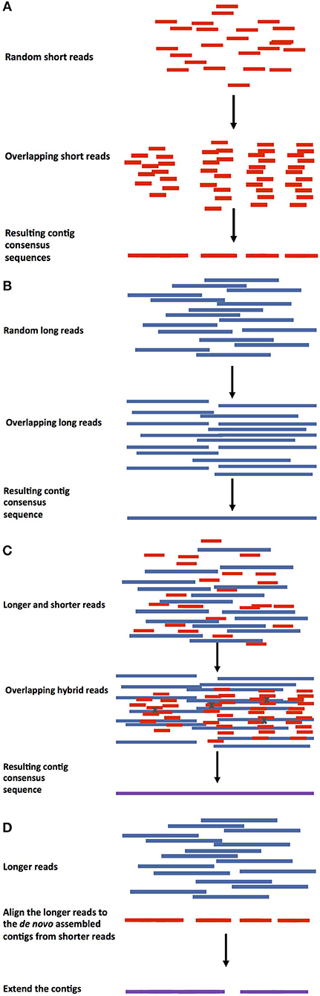
Generate a high-quality reference genome for G. maculatum
Collect anther tissue from each color morph in triplicate & extract RNA
Conduct a differential gene expression analysis

Slide 19
Estimate expression of structural & regulatory genes in the ABP
Normalize counts
FASTQs
I plan to use a similar bioinformatics pipeline that I used for my rotation project with Jim!
I will use GRFP Research funds in Fall 2023 to cover the costs of RNA-sequencing samples in triplicate for each morph.
EdgeR
Read trimming
Summarize
Trimmomatic
TXImport
Pseudo-alignment
DE Analysis
Kallisto
Sleuth/DeSeq2

Slide 20
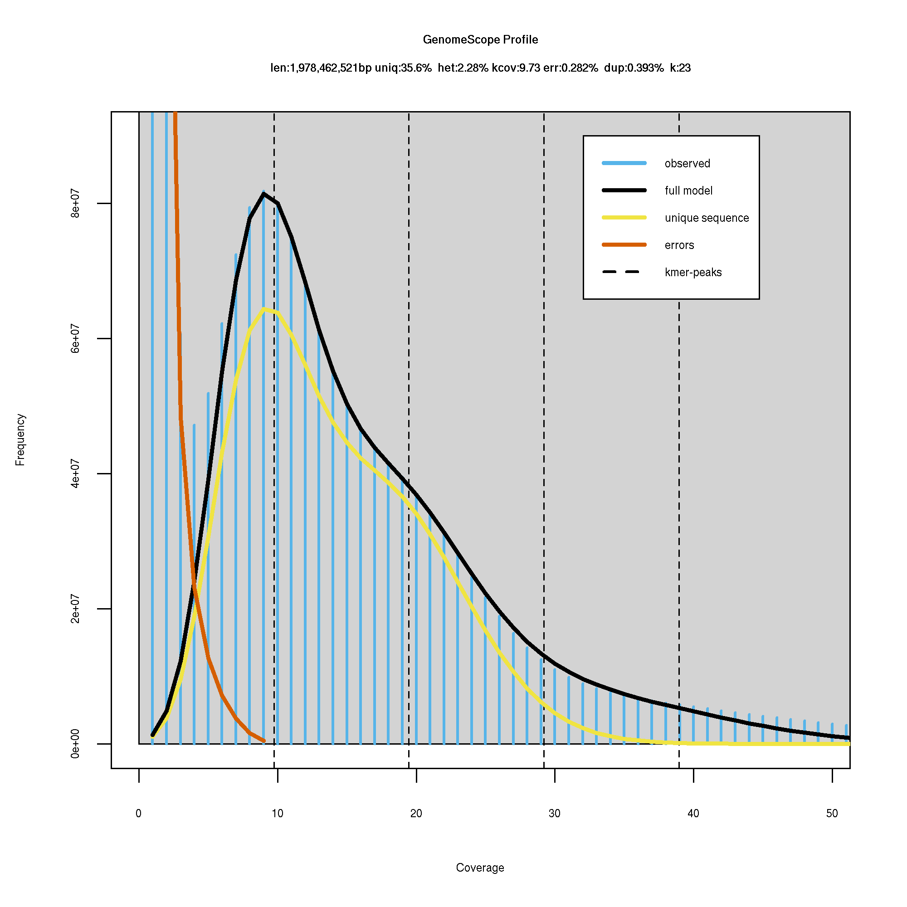
Preliminary results: K-mer analysis of whole genome shotgun sequence data
GenomeScope is a tool that estimates genome heterozygosity, repeat content, and size.
Genome size estimation: ~ 2Gb Heterozygosity: ~2.28% Unique sequences: ~35.6%

Slide 21
Question 2: How do difference in specialized metabolism influence plant phenotype and fitness?

Slide 22
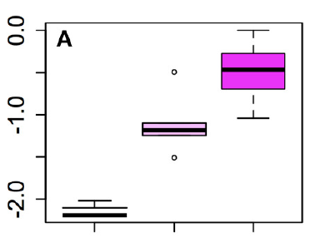
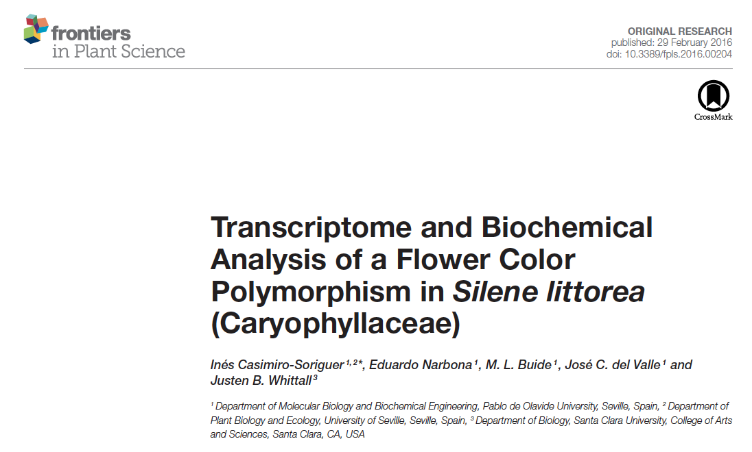
Collect reproductive & vegetative tissues
Dry samples & send to PML UPLC-MS facilities
Determine identity & quantity of flavonoid compounds

Slide 23
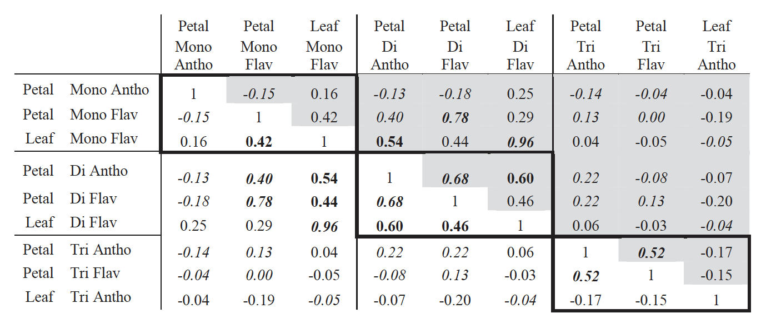
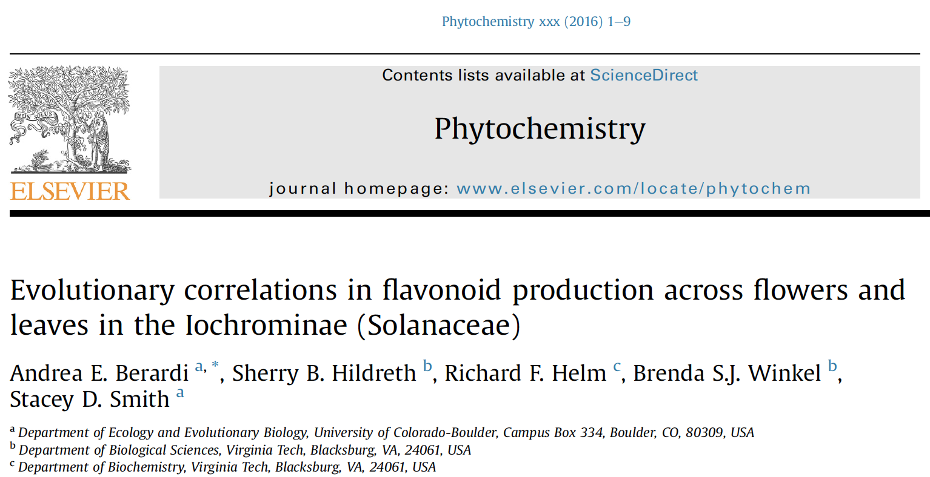
Collect reproductive & vegetative tissues
Dry samples & send to PML UPLC-MS facilities
Determine identity & quantity of flavonoid compounds

Slide 24
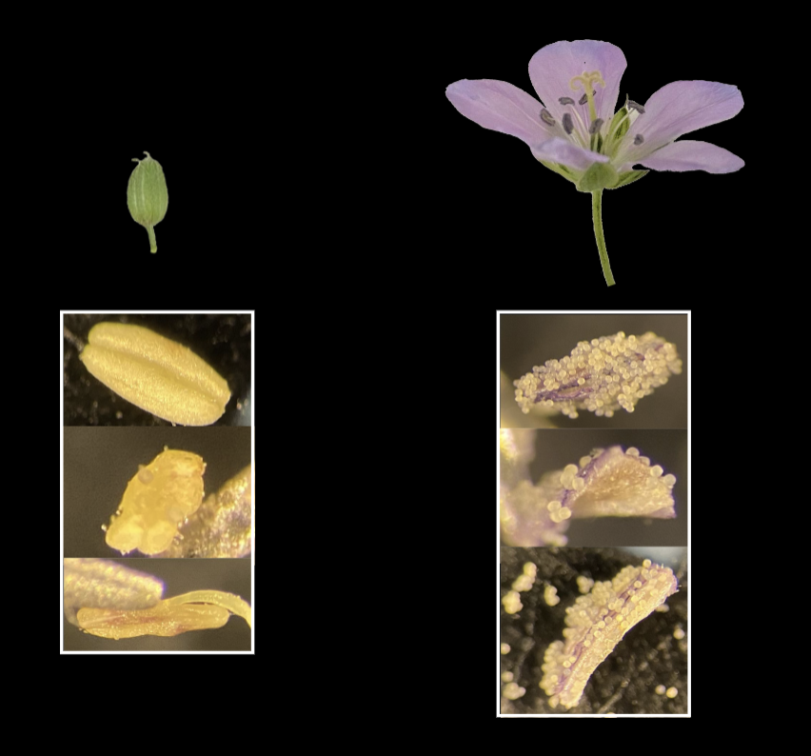
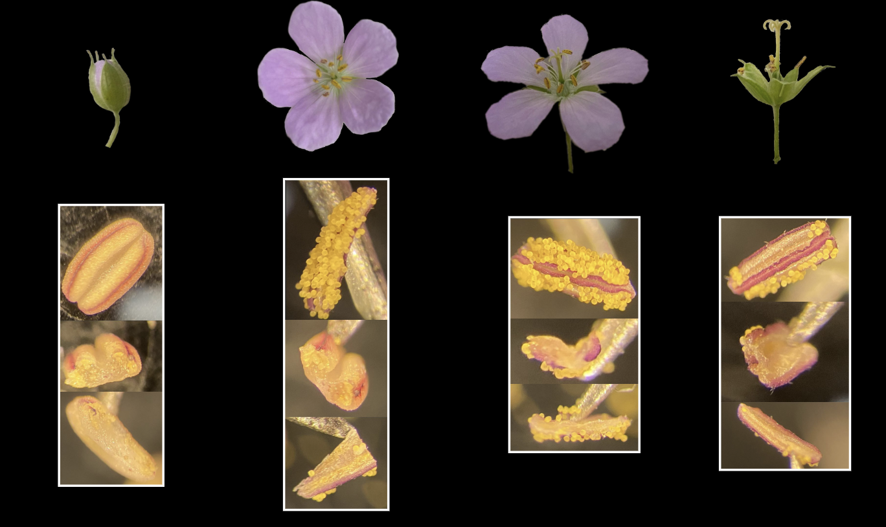
Challenge: Anther & pollen color phenotypes are not straight forward
G. Maculatum “purple” morph with light pollen
G. Maculatum “yellow” morph with purple anther & yellow pollen

Slide 25
Question 3: What associations are there with abiotic variables or biotic interactions that might favor the maintenance of polymorphism?

Slide 26
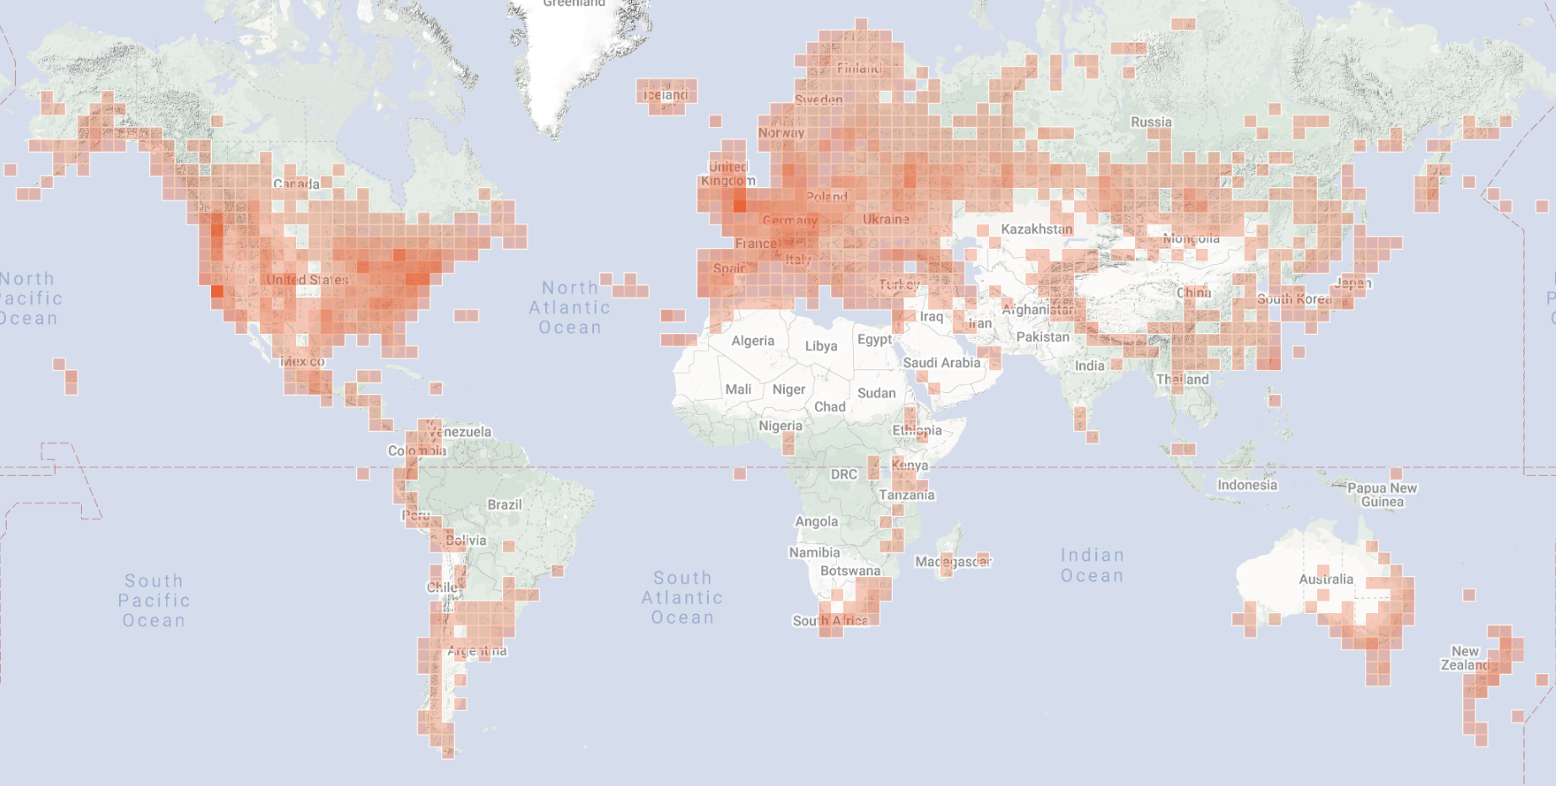
Mine publicly available images generated by citizen scientists to assess population-level color variation
G. cuneatum
G. pratense
G. lucidum
G. ocellatum

Slide 27
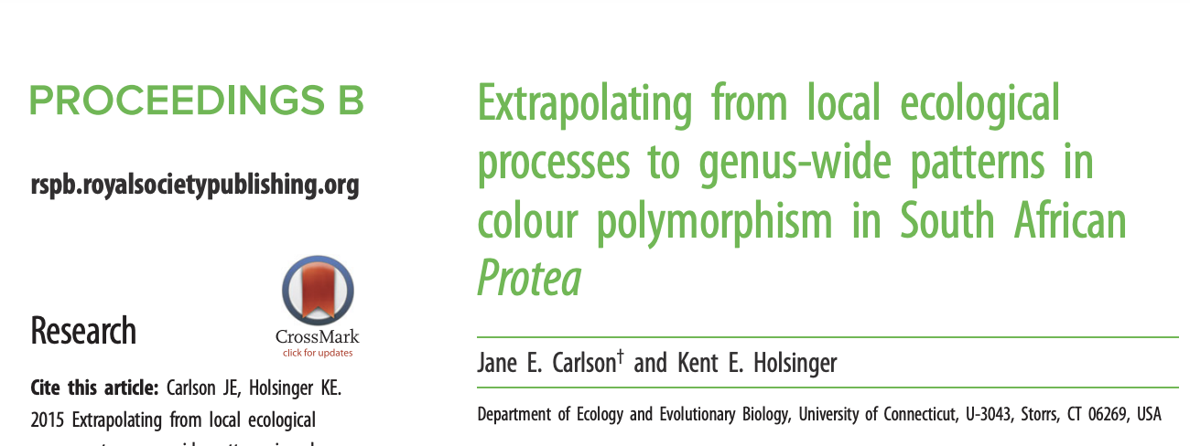
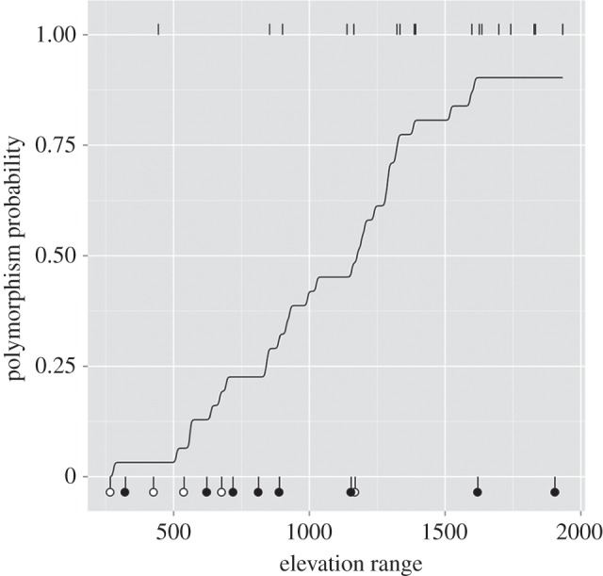
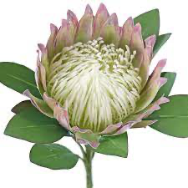
Use coordinate data from iNat to extract abiotic environment variables (e.g., longitude, elevation, mean annual precipitation)
Assign discrete color to iNat images
Test if polymorphism across species is associated with abiotic conditions
Colder temperatures, high precipitation, and high UV-B favor populations with high purple pollen frequency (Perez-Udell & Chang, 2022)

Slide 28
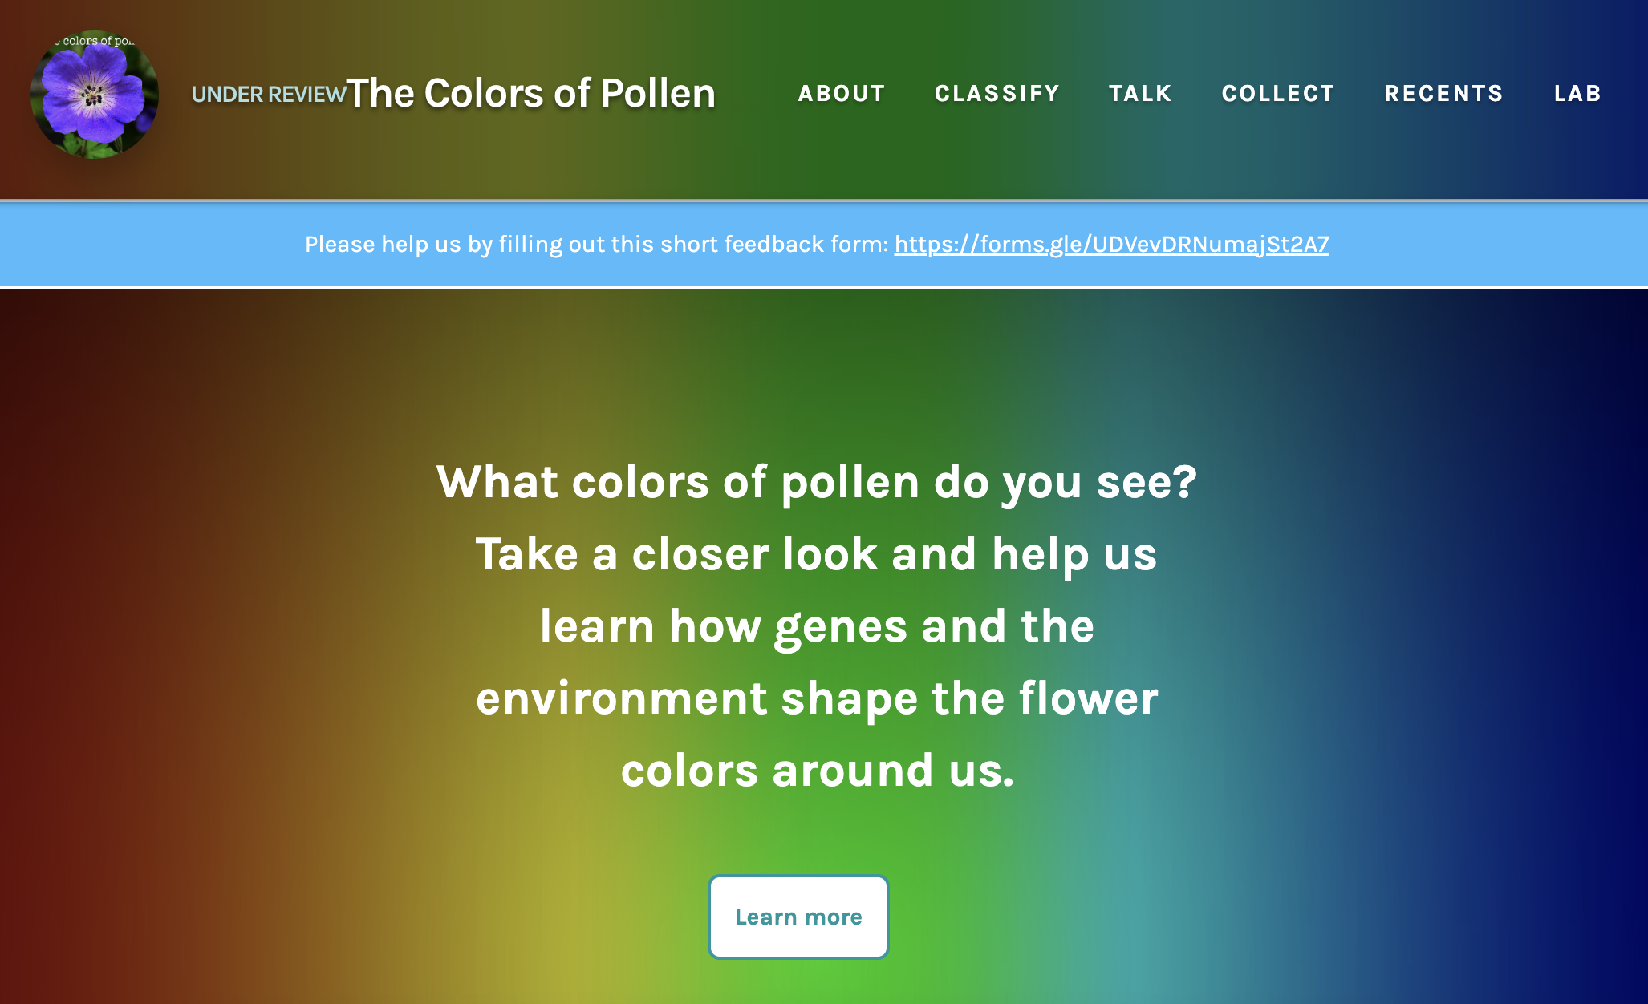
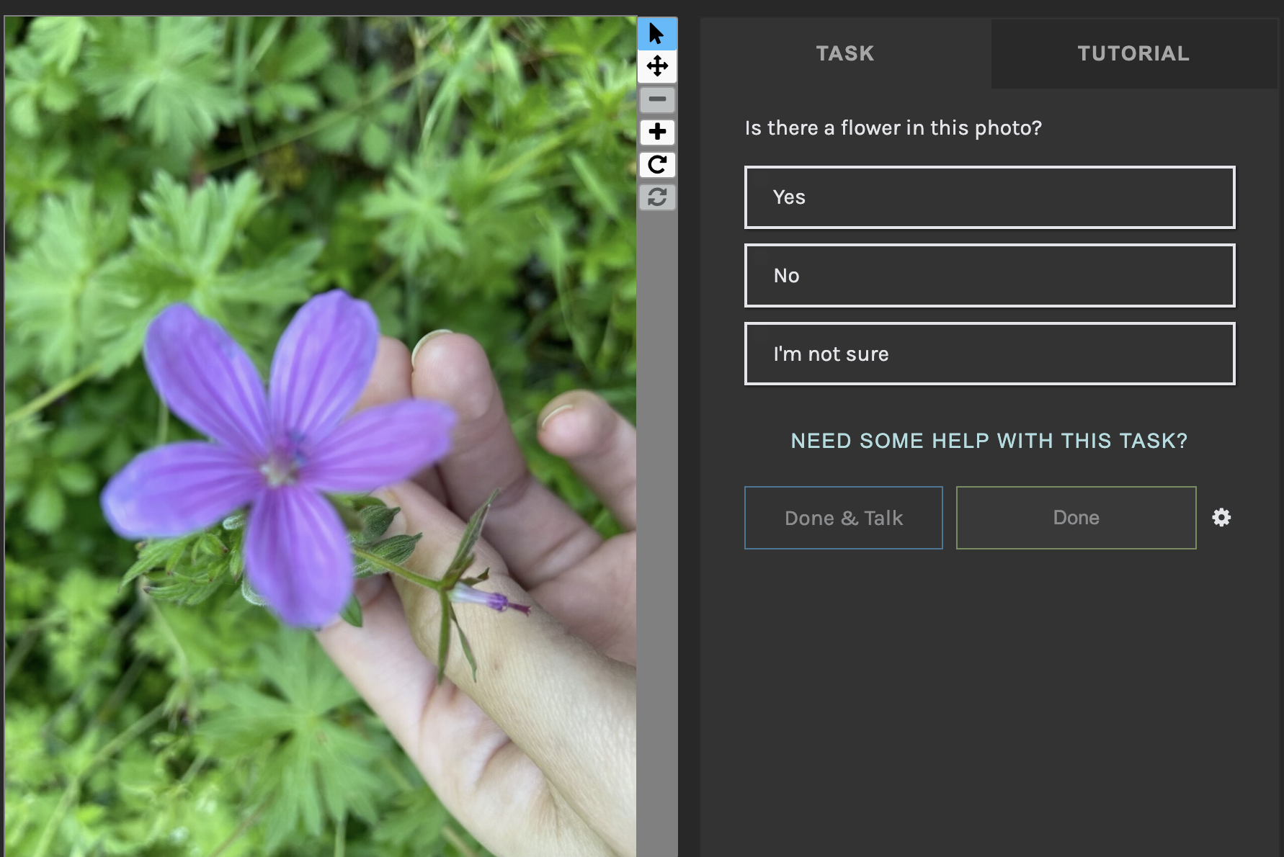
~271,468 observations of Geranium species on iNaturalist spanning ~100 species
Use digital participation platform (Zooniverse) to host images
Each image evaluate by multiple participants to assign discrete color

Slide 29
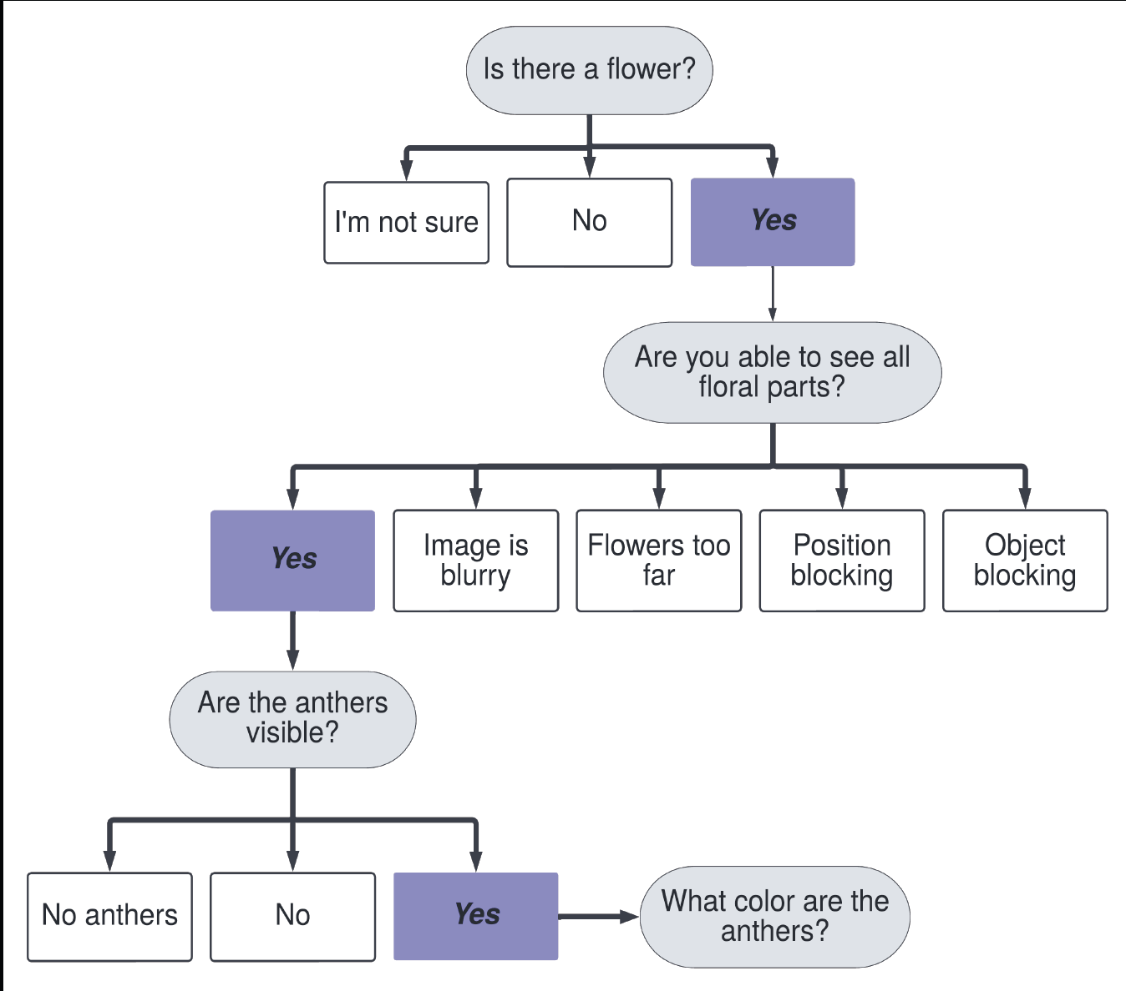
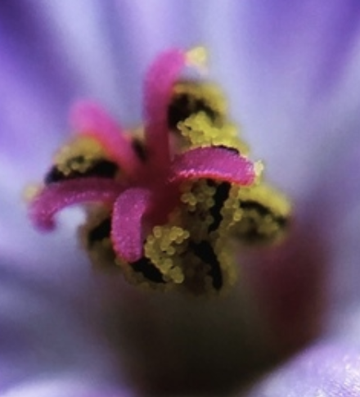
Preliminary workflow had lots of participation and participants enjoyed the tasks
Data required rigorous cleaning to assign color due to variation in color placement on anthers

Slide 30
Question 4: What processes shaped the evolution of flower color? How have organ specific morphological color phenotypes diverged over time?

Slide 31

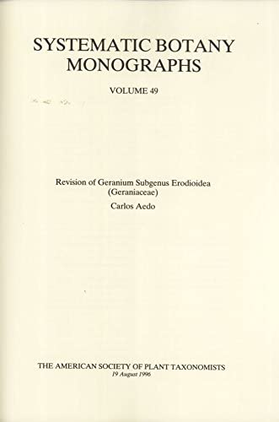
Literature Review – Geranium flower color
Created trait database of for 150+ species:
Anther color
Stigma color
Petal color
Petal vein color
Sepal color
Petal color polymorphism
Anther color polymorphism
Stigma color polymorphism

Slide 32
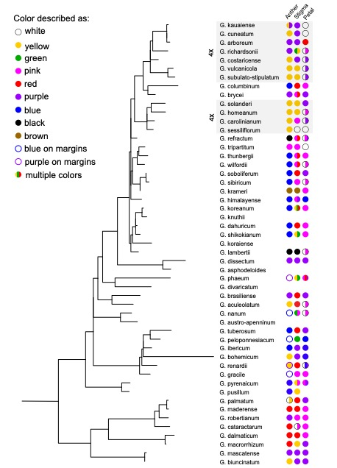
Ancestral reconstruction of various flower morphology traits using botanical monograph descriptions & data from citizen science projects
Maybe something with trait correlations between petal, anther, & stigma organs? Possibly other traits extracted from herbarium records?
Plan to update phylogeny for Geranium

Slide 33
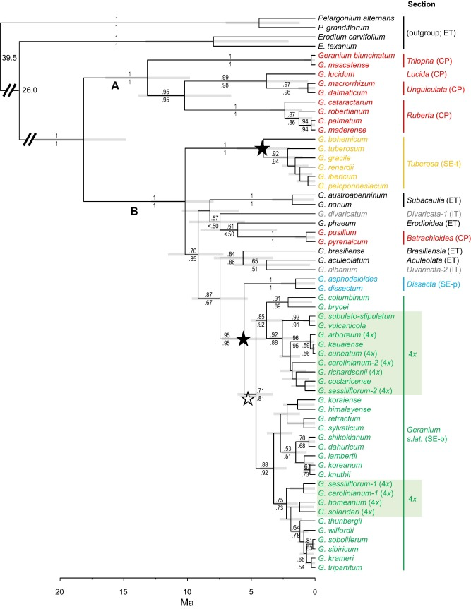
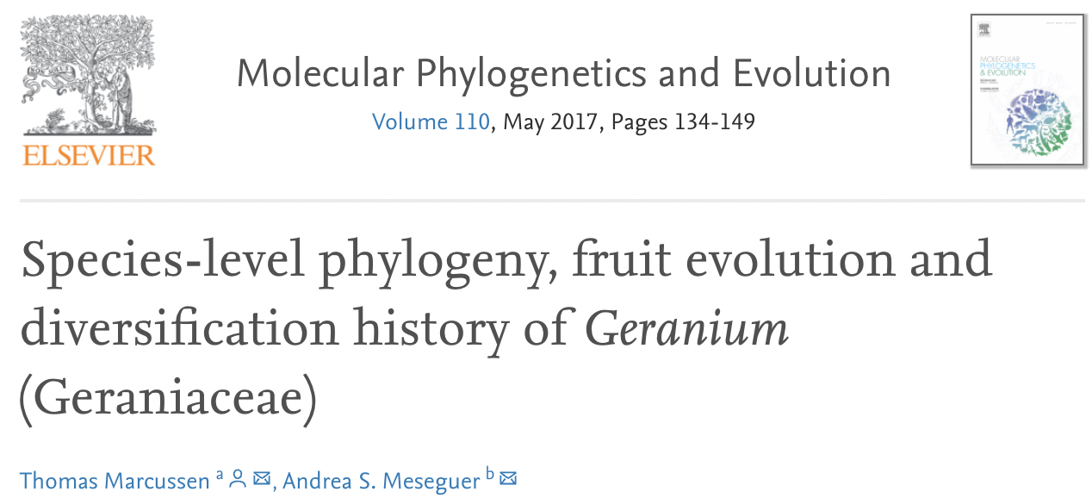
54 Geranium species
chloroplast (rbcL, trnL-trnF) and nuclear (ITS) DNA sequences
G. maculatum not included

Slide 34
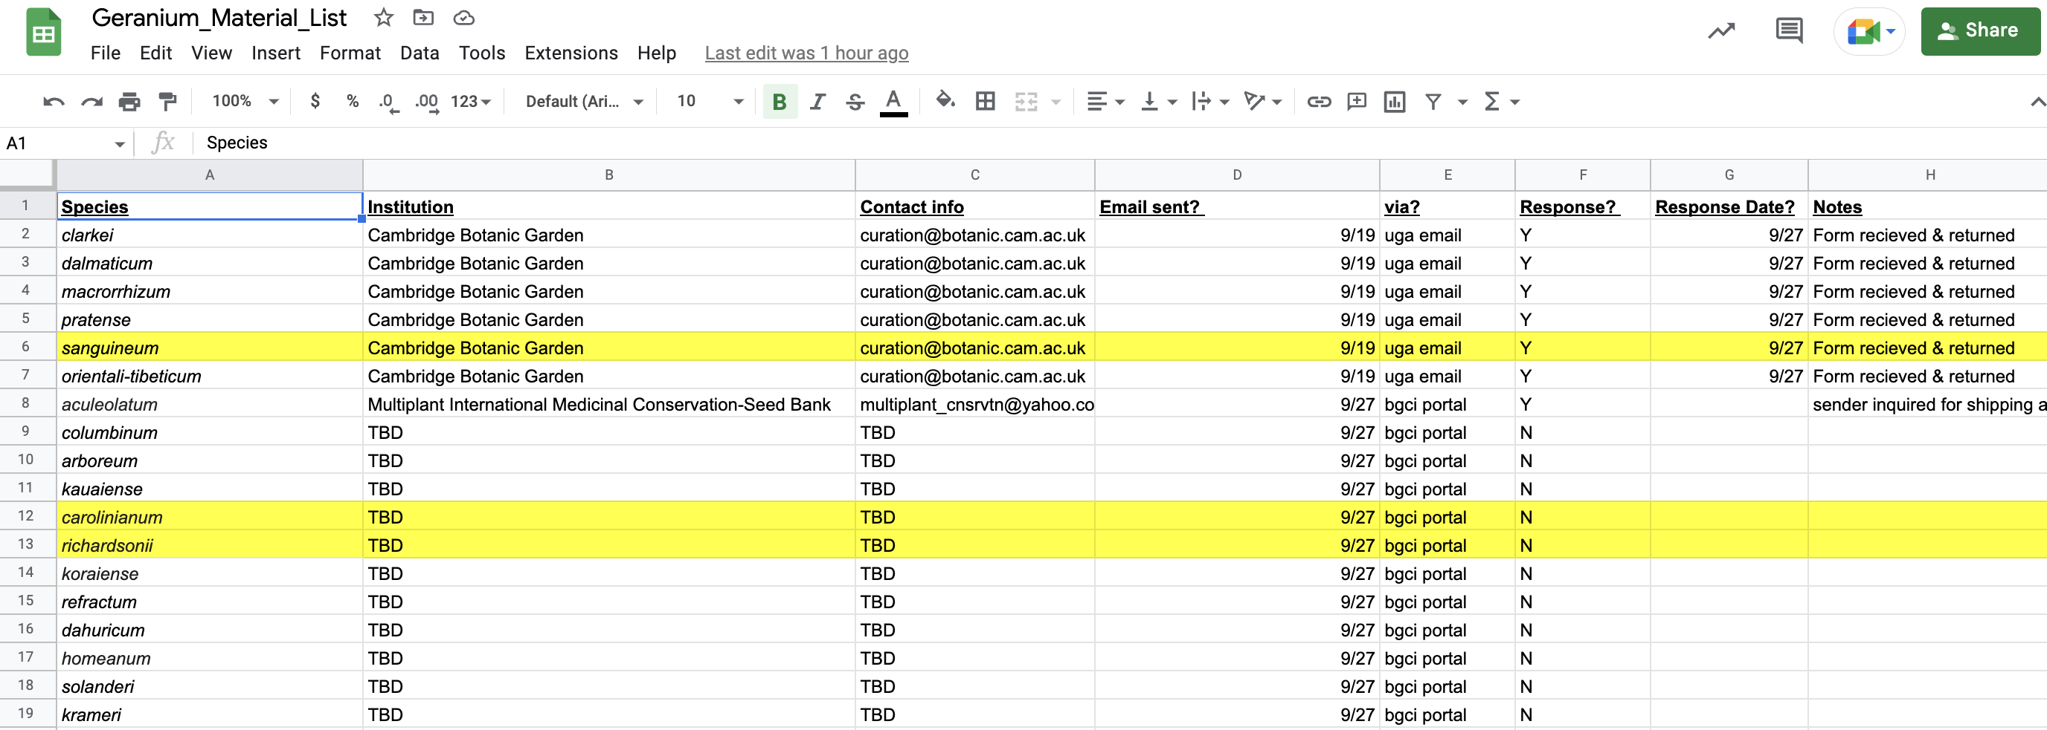
List of ~40 species in same clade as G. maculatum + availability in live collections across US & UK.
Currently coordinating material for several species!

Slide 35
Timeline
Year 2 Spring
Year 2
Summer
Year 3 Fall
Year 3 Spring
Year 3 Summer
Coursework
TA
Small grant applications
Coordinate material transfer for phylogenomics
Collect material for RNAseq & metabolomics
Preliminary UPLC analysis
Send DNA for PacBio sequencing
Phylogenomics DNA extractions & library preps
Launch Zooniverse
Prepare for comps
Comps
Send RNA for Illumina sequencing
Genome assembly
Submit NSF INTERN application
RNA-seq analysis
Collect material for metabolomics*
Small grant applications
Natural History Museum Internship
Send material for phylogenomics*
*Funding not confirmed

Slide 36
Timeline
Year 2 Spring
Year 2
Summer
Year 3 Fall
Year 3 Spring
Year 3 Summer
Coursework
TA
Small grant applications
Coordinate material transfer for phylogenomics
Collect material for RNAseq & metabolomics
Preliminary UPLC analysis
Send DNA for PacBio sequencing
Phylogenomics DNA extractions & library preps
Launch Zooniverse
Prepare for comps
Comps
Send RNA for Illumina sequencing
Genome assembly
Submit NSF INTERN application
RNA-seq analysis
Collect material for metabolomics*
Small grant applications
Natural History Museum Internship
Send material for phylogenomics*
Metabolomics Phylogenomics Genomics Transcriptomics Citizen Science
*Funding not confirmed

Slide 37
Classes

Slide 38
Taken
Fall 2021
IPS requirements
Research techniques
Professional development
Responsible conduct of research
Plant Reproduction and Physiological Ecology
Spring 2022
Graduate Teaching Seminar
Experimental Design
Molecular Phylogenetics and Evolution
Fall 2022
Applied Genome Analysis
Writing Intensive Pedagogy
Currently
Spring 2023
Grant Writing Seminar
Teaching Biology Seminar
Functional Genomics
Still need
1 more required seminar
Courses of interest:
QUAL 8400E - Qualitative Research Traditions
QUAL 8410E - Designing Qualitative Research
QUAL8420E - Analyzing Qualitative Data
Evolutionary Genetics or Advanced Genetics

Slide 39
Outreach

Slide 40







Year 1
Cientifico Latino Mentor
Student Speaker Fellowship
Botany PLANTS Mentor
CIRTL Research Mentor Training
Year 2
Athens Clarke County Seed Lending Library
Athens Science Café
VP of Events
Integrated Plant Sciences Program
Diversity Preview Weekend ($4500
procured)
PBIO retention grant proposal ($5000 procured)
Software Carpentries Instructor training

Slide 41
Internship

Slide 42

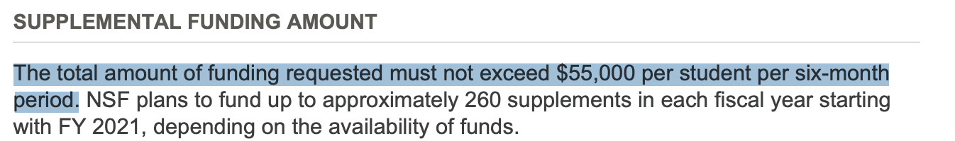
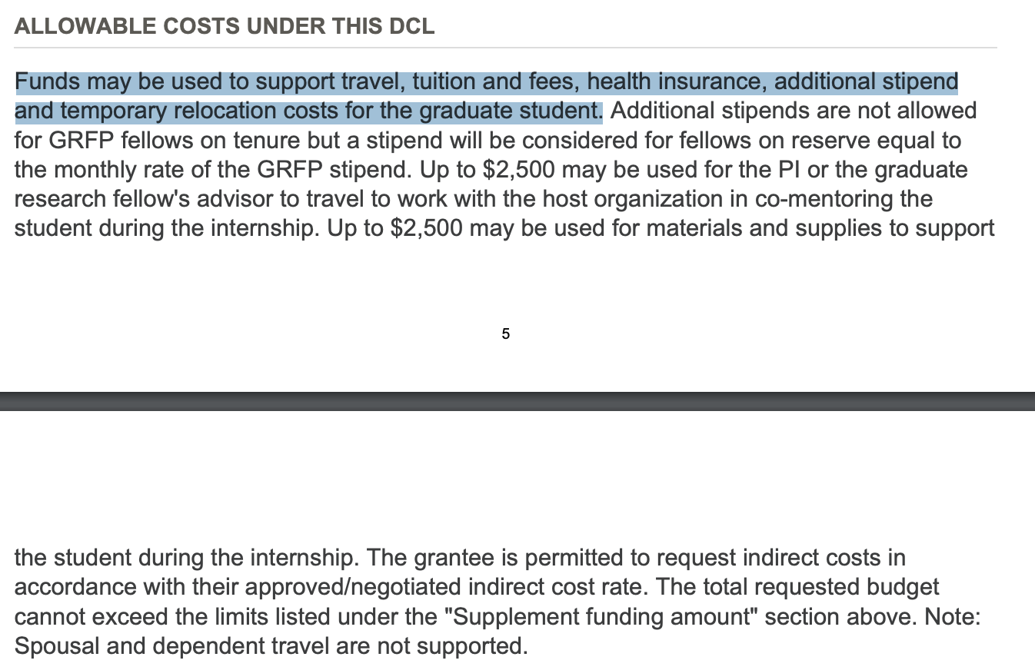

Slide 43


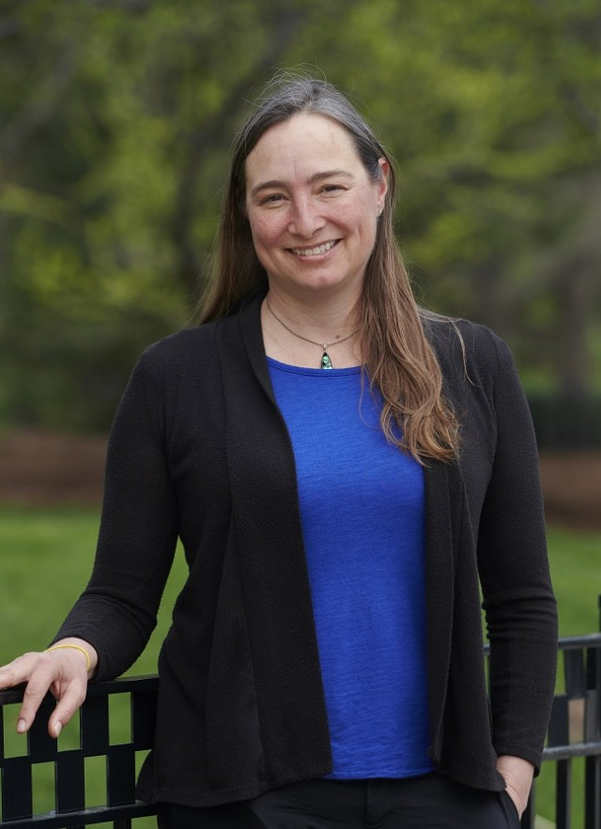
NSF INTERN Supplemental Funding
Professional development in:
K-12 museum education
Museum exhibit design
Analyzing audience & engagement data
Citizen science outreach
Volunteer management
Preview into potential career path
Networking!
Proximity to family & where I plan to live post-PhD
Regan Dunn
La Brea Assistant curator
Paleobotanist

